Slide 1


PROGRAMMING
Unit 4 | Mr Butler
Digital Technology

Slide 2


describe the following programming paradigms:
  procedural programming;
  object-oriented programming;
explain the significance of the following aspects of software development environments:
  editing features;
  high-level code translation and execution

Slide 3



What is a Computer Program?
A set of instructions that tells a computer what to do in order to solve a particular problem.
There are a number of approaches to the programming process, and these are known as programming paradigms. They take input (data), and then process it to output information.
Two of the most important paradigms are:
Procedural
Object Oriented
PROCESS 1
Fruits
PROCESS 2
🍎
🍓
🍑
PROCESS 3

Slide 4

Data
All computer programs ‘deal with’ data. They may read data, process data, output data, etc. This may be simple data such as numbers or characters or more complex data such as student records.
This data needs to be stored somewhere ‘within the computer’ so that is can be accessed whenever necessary.
To do this, programs make use of variables which are simply named locations or blocks within the computer’s memory.

Slide 5


Variables and Constants
Understanding the difference between variables and constants is crucial for writing clear and maintainable code.
A variable is a named memory used to hold data being processed which can change during the programs’ execution. They are given a name and data type.
A constant is a named location in memory used to hold data that cannot be changed while the program is running. It is a value that can be assigned but remains the same throughout the program.

Slide 6

Why use constants?
If the programmer needs to change a value in the program, the value of the constant only needs to be changed in a single place, making it much easier to reassign a value.
This is because the change is reflected throughout the program.

Slide 7



Why use variables?
Data
Variables are vital to programming useful applications, as a program’s whole purpose is to actually process data. This can’t be done without using variables in one way or another.
Declaring variables is usually the first thing that happens in any program.
Variables need to be given a name
Most programming languages also ask to know what type of data this needs to store
The variable itself (the actual memory location doesn’t change), but the data that is held at that location can change when running the program
VARIABLE

Slide 8
Data Types
There are lots of data types available in programming – and we have already met many throughout this course.
The most common data types are:
  String: Used to store a text value
  Char: Used to store a single character
  Int: Used to store a whole number
  Double: Used to store a number with a decimal point
  Bool: A yes or no/true or false value
  Date/Time: Used to store a date or time

Slide 9

Variable Names
Computer programs require all variables and constants to be given a name in order to refer to them.
There are certain rules for variable names:
  No reserved words
  Cannot start with a digit (but digits can be used after the first character i.e. name1, n2ame, etc)
  Start with a letter, an underscore, or a dollar sign
  Should start with lower case.
Your variables should always be meaningful. If each variable has a name that makes it clear what it’s being used for, it will make finding errors in your programs a lot easier.

Slide 10
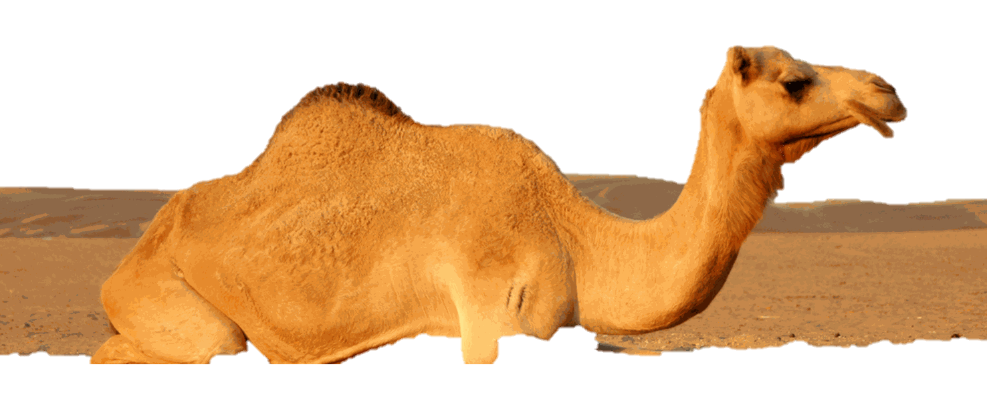
camelCase
There are a number of different naming conventions that are available in programming, and for some languages it is more common to see these than others.
When we write variables, when we use compound words or phrases
Each new variable starts with a lower-case letter, and then subsequent abbreviation/next word begins with a capital letter.

Slide 11
Hello, World!
This is one of the easiest and most common ‘first programs’ you will see when learning any programming language.
From here, we can start adding more features, including adding user input. And then even adding storing this data into a text file.
This can then progress to decision making by using conditions – i.e. asking questions (if statements), or repeating tasks using repetition – i.e. loops

Slide 12

Developing Programs
It is important to know that when you have a BIG or COMPLEX problem, that programmers don’t magically come up with a solution.
Programmers and Computer Scientists use different ways to design and implement their code in order to ‘solve’ the bigger problem.

Slide 13
Programming Paradigms
A program in its simplest form is a set of instructions that tells a computer what to do in order to solve a particular problem
There are a number of approaches to the programming process, and these are known as programming paradigms.
  Each adopts a different approach to programming/coding a solution
  Two of the most important paradigms are:
    Procedural paradigm
    Object Orientated paradigm

Slide 14
Procedural Programming
In our example of the cup of tea, we could create an entire function called makeTea();
This process doesn’t change, but it can be called at any time in the program’s execution.
We could make a “get up” program, consisting of multiple procedures:
wakeup();
makeTea();
goToSchool();
learnSubjects(“Mathematicss”);
learnSubjects(“Digital Technology”);
learnSubjects(“English”);
goHome();
makeTea();
goToBed();
This way, we don’t have to keep writing out the same functions over and over again. The “makeTea();” function only needs to be designed once.
Relies on implementing procedures (aka functions or sub-routines)
Procedure: A named subroutine or block of code written to perform a specific task, which can return a value and have parameters.
Top-down design involves breaking a complex problem down into smaller sub-problems
  Includes variables, data structures and programming structures
  Important to have functions in order of running.
  A program is made up of a number of functions/procedures which can be called repeatedly

Slide 15
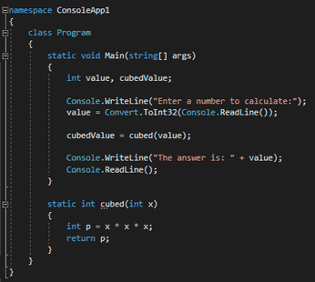
So, What is this program doing?
How do you know?
This is an example of procedural programming

Slide 16
User Defined Functions
In our example of the “getUp” program, we had created a number of sub routines, or user defined functions.
For example, we had parameters for learnSubject(“mathematics”);
The “Mathematics” is being used as an input into this user defined function.
We don’t have an output to this yet, but we could have a variable such as “lastTopicLearnt” in the main thread of the program;
string lastTopicLearnt = “”;
wakeup();
makeTea();
goToSchool();
lastTopicLearnt = learnSubjects(“Mathematicss”);
lastTopicLearnt = learnSubjects(“Digital Technology”);
lastTopicLearnt = learnSubjects(“English”);
goHome();
makeTea();
goToBed();
output lastTopicLearnt;
The main thread now will get access to something like “Similies” which came out of the user defined function
User defined functions are procedures or sections of code written to perform a specific task. They can be given parameters as inputs.
These can return (output) a value back into the main thread of the program.
helps code readability
creates re-useable code, enhancing code efficiency
can be designed and tested individually, with errors being easier to identify.

Slide 17
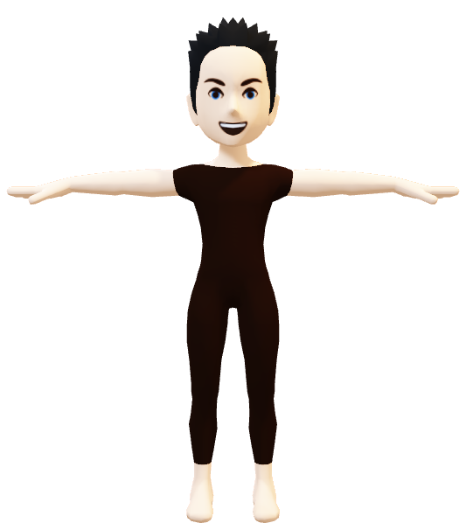
Object Oriented Programming
PUPIL OBJECT
Uses the concept of objects
  This object contains properties (data) being processed
  The tasks being performed on the properties are called methods.
  An object is an instance of a class containing variables, functions, and data structures.
A Class defines the properties and methods for a group of objects, (a bit like a template or blueprint), where each class can instantiate many individual objects.
pupilName
gender
favouriteColour
favouriteAnimal
pupilAge
Pupil firstPupil = new Pupil(“Alex”, M, “Blue”, “Dog”, 15);
We can now interact with the object with functions such as getPupilGender() and getting an output from the object of “Male”

Slide 18
Object Oriented Programming
PUPIL OBJECT
pupilName
OOP also allows for relationships between two objects, known as inheritance.
  One class can inherit properties and methods and then only the differences in the derived (child) class need to be programmed.
gender
favouriteColour
favouriteAnimal
pupilAge
Pupil firstPupil = new Pupil(“Alex”, M, “Blue”, “Dog”, 15);
We can now interact with the object with functions such as getPupilGender() and getting an output from the object of “Male”

Slide 19
Features of OOP: Inheritance
Inheritance
This is the ‘parent class’. All humans have a name and age attributes.
HUMAN
name:
age:
Employee Student
salary: course:
position:
These are two derived classes. An employee will also have a salary and position in addition to the name and age attribute.
A Student will also have a course in addition to the name and age attributes.
Inheritance is how the properties and methods from a class are copied to another class so that only the differences must be reprogrammed.
A derived class is a class resulting from the inheritance process.

Slide 20

Encapsulation
Also known as information hiding
Encapsulation is an object-oriented programming concept where data (properties) and the methods that operate on that data are kept together within an object.
The data inside an object is hidden from direct access and can only be changed or accessed through the object’s methods. This helps to protect the data from accidental or unauthorised changes.
Encapsulation improves program reliability and security, as each object controls how its own data is used.
Attributes
Methods
Eat();
Throw();
Describe();

Slide 21

Benefits of OOP
Code for an object can be programmed and maintained independently (code maintainability)
Code for an object can be reused in different programs by different developers (code reusability)
Details of the objects’ implementation are hidden from the outside world, so direct access to the object’s data is reduced (code security and code efficiency)

Slide 22

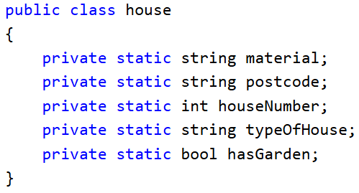
Example of OOP
Here we are going to make a house object.
It has 5 attributes in this example (material, postcode, houseNumber, typeOfHouse, hasGarden)
These attributes are private – this means you cannot access this information as you are external to the house.

Slide 23
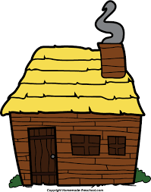
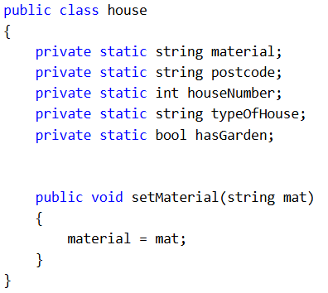
Example of OOP
We can add a method which allows us to access the attribute
In this example, we are adding a way to assign the material of the house in the form of a method.
We can now use something like
setMaterial(“straw”);
Which will set an object’s material property.
Method name
Value we are setting it to
Attribute we are assigning

Slide 24
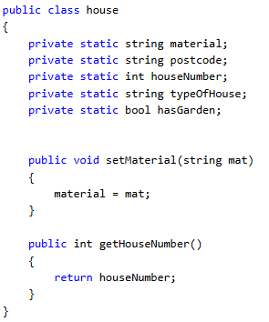
Example of OOP
67
We may want to get a response from an object to find out what value is assigned as a certain attribute, for example its set houseNumber.
We can do this by creating a method called
getHouseNumber();
The data type coming out of the method
No input
The output

Slide 25
Software Development Environments
We can write very basic programs using text editors, such as notepad.
  This is not ideal and is very inefficient as you still need to translate the code we write into binary (machine code) which the computer can actually execute.
Instead, we use an Integrated Development Environment which provides programmers with all of the facilities required to complete the development of an application – from design elements to testing.
This means that a program can be developed within a single application.
Provides an integrated set of editing, compiling, and debugging tools for programmers, enabling applications to be built from coding to testing.

Slide 26
Features of an IDE
Source Code Editor
The basic window where a programmer writes and edits their program’s source code.
Compiler
A specialized translation software that converts human-readable source code into machine code (binary format of 1s and 0s) so it can be understood and executed by the computer.
Debugger
An integrated facility used to identify, trace, and correct software errors (bugs).
Graphical User Interface builder (with toolbox)
A visual design tool used to build user-friendly forms and design the interactive portion of the application that the user operates.
Solution Explorer
An administrative component of the IDE used to manage and navigate the overall structure of the programming project

Slide 27
Clipboard
Allows programmers to copy items and choose which one to paste into the current code file
Line Numbering
Displays numbers alongside code to help programmers distinguish between lines in lengthy coding sections
Syntax Error Assistance
Places "wavy lines" beneath code that is incorrect or problematic as it is entered - using red for syntax errors, green for warnings, and blue for semantic errors
Code Outlining / Collapsible code sections
Allows programmers to collapse or expand selected regions of code under their first lines so that long programs can be viewed in small, logical sections
Intellisense
Displays the complete syntax and arguments of a statement or function in a ToolTip as you type, and provides popup insertion lists of available functions, statements, constants, or values to complete a statement
What Editing Features Exist in an IDE?

Slide 28
Compiling Code
Compiler
Translates source code into binary format / machine code so that it can be understood and executed by a computer. It attempts to translate the entire code at once. If there are errors, the code will not compile/run.
Interpreter
Translates the source code line by line. The processor fully executes a translated line of code before moving on to translate the next line. This is good for unfinished products where you only want to run a section of code.
High-level source code is readable by humans, but it must be formally translated into machine code (binary format of 1s and 0s) before a computer hardware system can understand and execute it.
Translators typically perform this task using one of two approaches: compilers or interpreters

